Slide 1

Detecting Plant diseases and Suggest pesticides
IT18181784 | LATHUSHA SRITHARAN
INFORMATION TECHNOLOGY

Slide 2
Research Question
Farmers are facing problem by plant diseases. Some new farmers don’t know the diseases name and management. They spend long time to find diseases and treatment . How E-Commerce System for farmers will help to farmers to find diseases and to get idea for cure diseases.
Objectives and sub Objectives
Provide an effective method to find diseases in plant, specially in tomato and rice plant.
Implement Most Accurate User friendly Method to Analyze plant diseases.
suggest pesticide and management method for particular diseases.

Slide 3
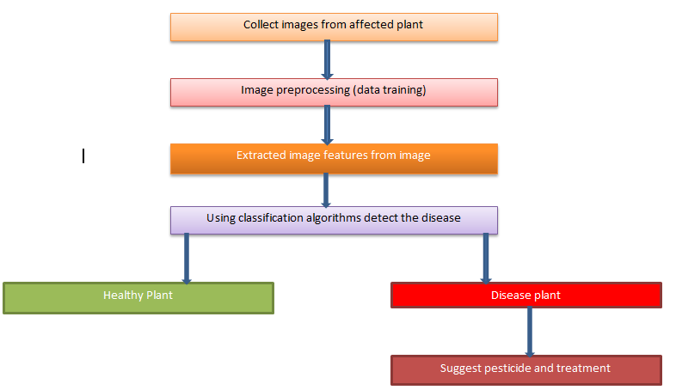
Methodology
Using deep learning
CNN algorithms

Slide 4
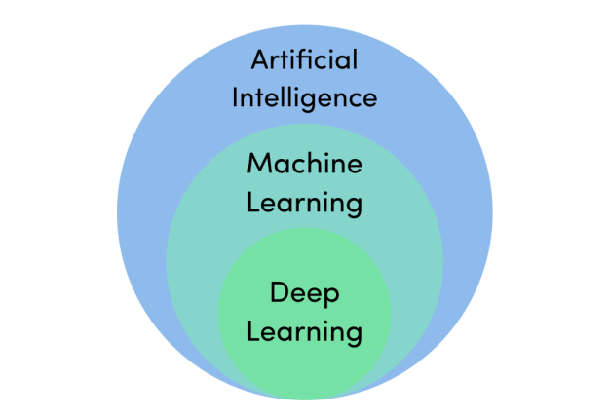
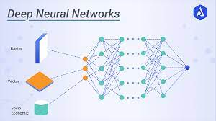




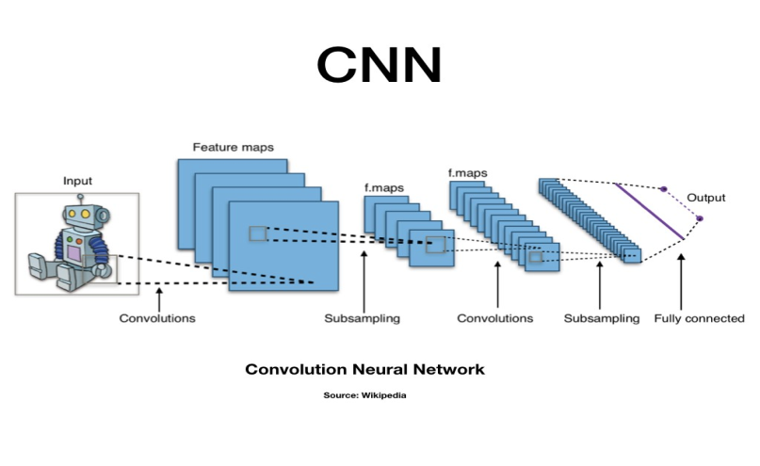

Key Pillars and Technologies
Technologies
Key Pillars

Slide 5
Achievements and Individual Progress
analyzed the requirements & Dataset
Check Key Pillars and Technology Feasibility
Planning the Method for the plant diseases Analysis
Collect images for different types of diseases in plant.
Design and Develop the Analysis Model
Train the Model Using Dataset
Get most accurate result using test data

Slide 6
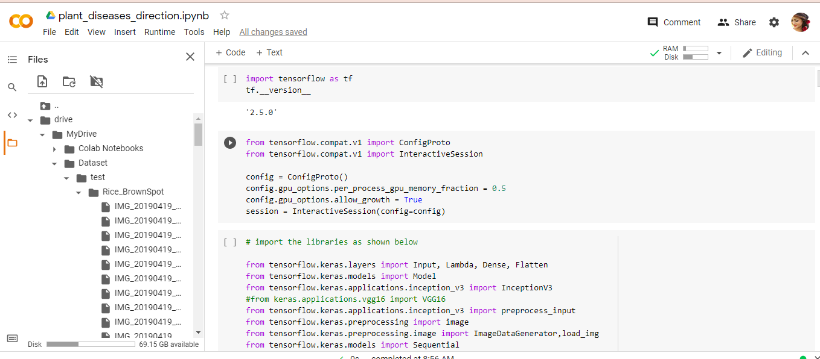
Achievements
Data Training method

Slide 7
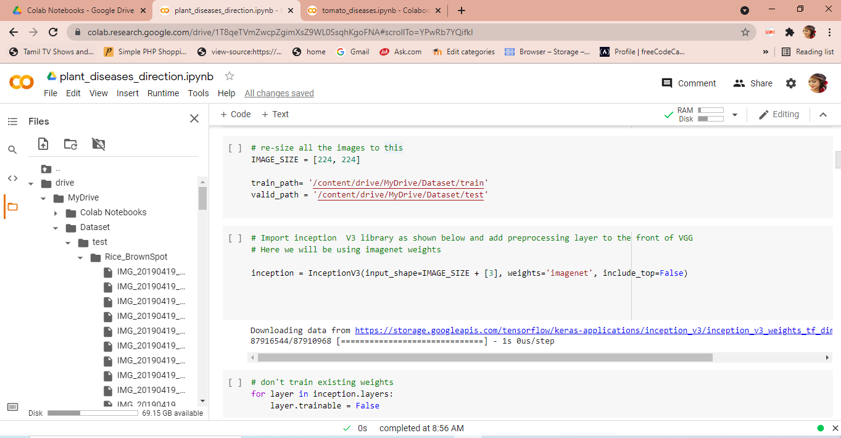

Slide 8
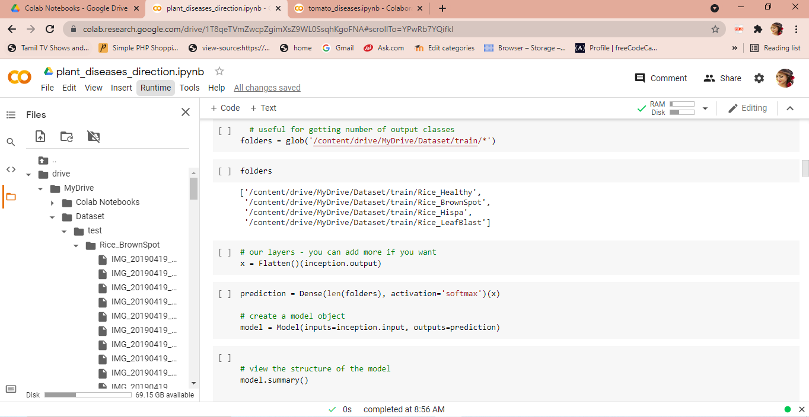

Slide 9
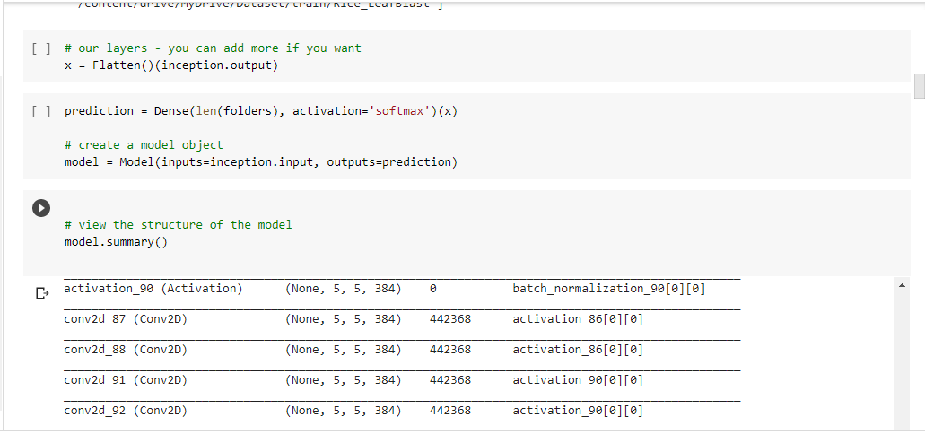

Slide 10
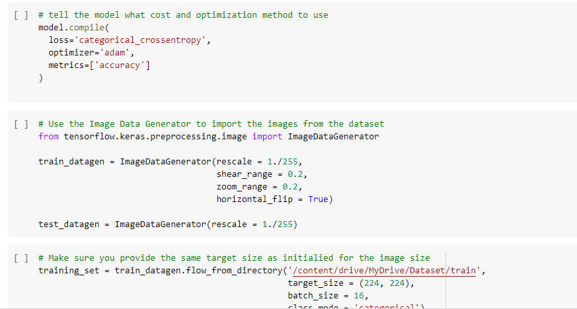

Slide 11
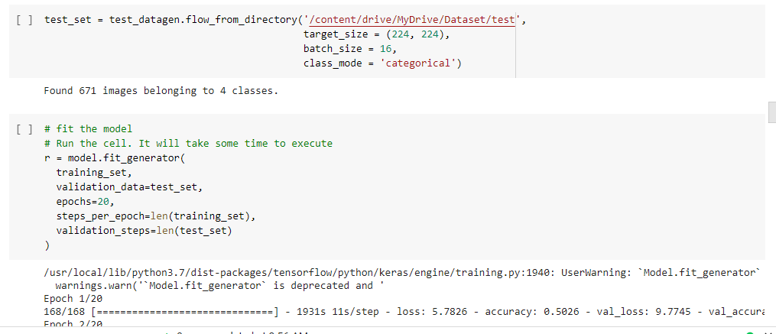

Slide 12
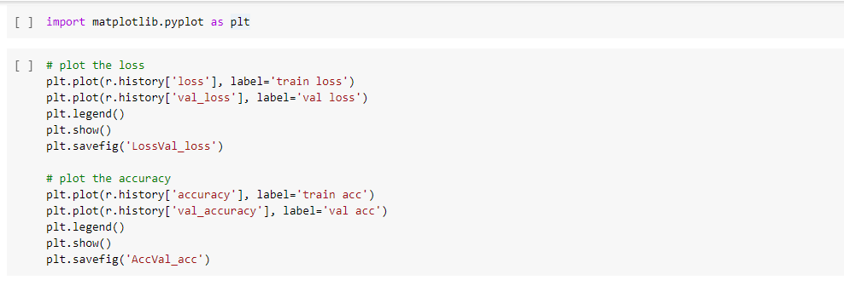

Slide 13
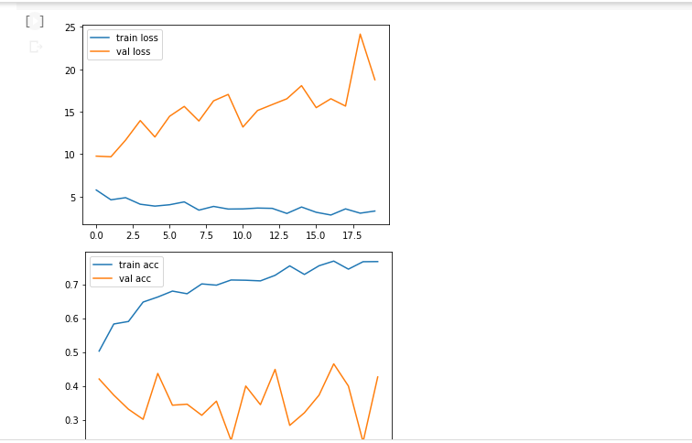
Accuracy matrix

Slide 14
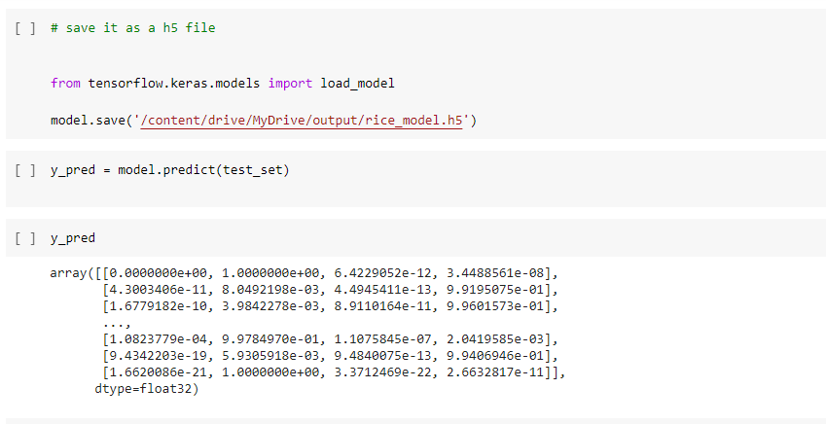
Save the model

Slide 15
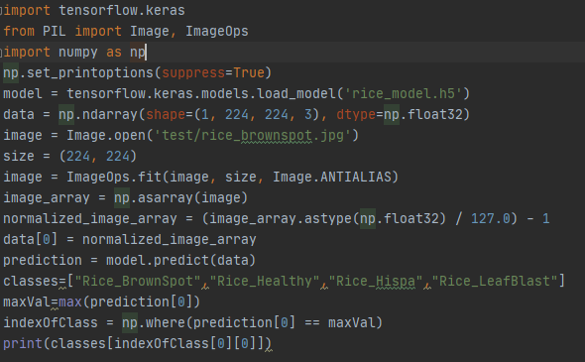
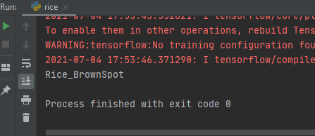
Method for detecting rice diseases using trained data

Slide 16
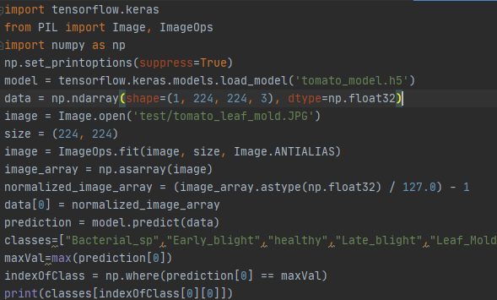
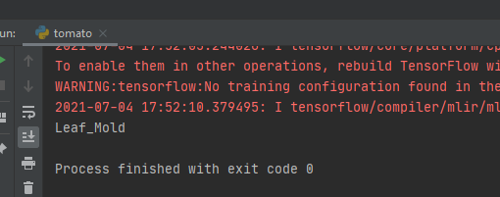
Method for detecting tomato diseases using trained data

Slide 17
Task to be Achieve
Implement a method to give pesticide and management suggestion for every diseases .
Develop user friendly interface to find diseases by images and suggest pesticide and management
Develop a method to find diseases and suggest pesticide in mobile App using past trained dataset
Improve this modal to get most accurate result

Slide 18

Agropanda
(Farmers platform)
Project id – 2021_135
R. Jayaraman
IT16037984

Slide 19
Main Objective
Creating a platform for farmers
Sub objectives
Suggesting suitable crop
Price prediction
Suggesting pesticides
Chatbot for user requirements

Slide 20
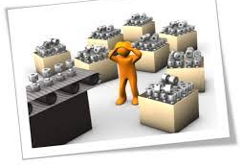
Vegetable recommendation
Recommending crops for farmers according to
weather condition
soil type
location.

Slide 21
Research gap
We need more data to build the model
We can improve the accuracy
Research questions
RQ1- Which machine learning algorithms have been used in the literature for crop yield prediction?
RQ2- Which features have been used in literature for crop yield prediction using machine learning?
RQ3- Which evaluation parameters and evaluation approaches have been used in literature for crop yield prediction?
RQ4- What are challenges in the field of crop yield prediction using machine learning?
Introduction

Slide 22
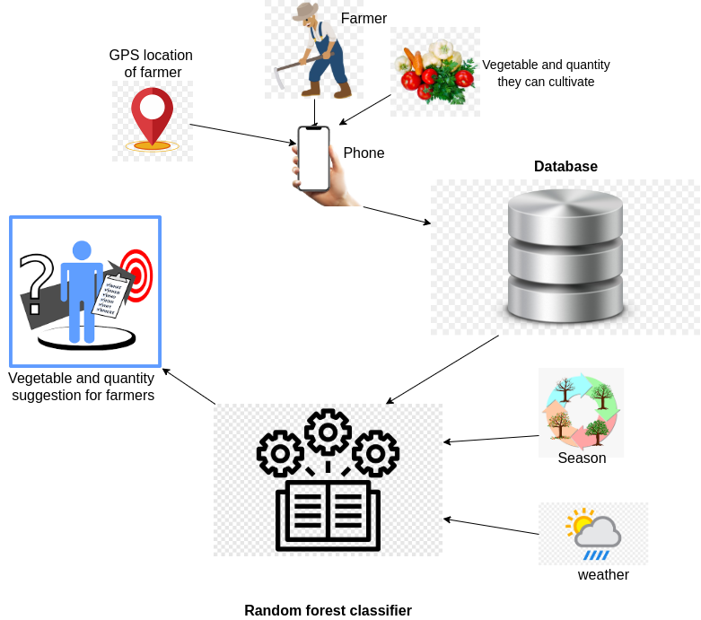

System Overview Diagram
AI Model

Slide 23
Objective
Suggest the suitable vegetable to cultivate
Sub objectives
Collect datasets
Build model & Test accuracy
Develop application

Slide 24


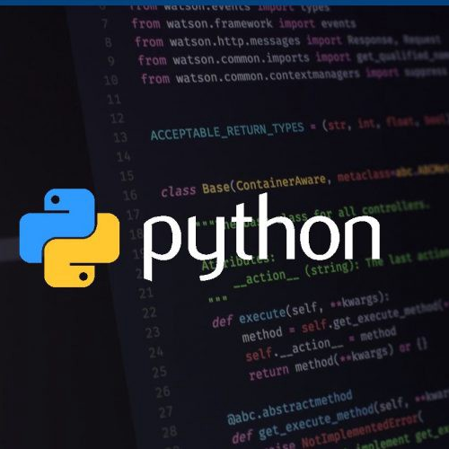

Methodologies
Artificial neural network
Logistic regression
Python
Android

Slide 25
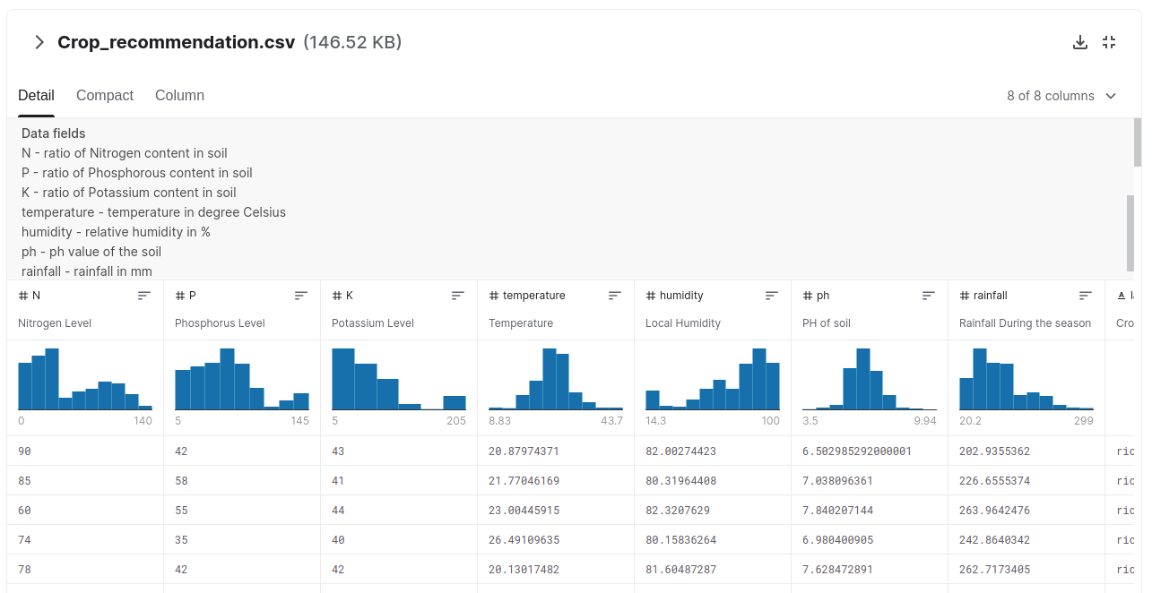
Kaggle dataset

Slide 26

Completion of the project
Collect the data from Kaggle
Build models using
1. Logistic regression algorithm
2. Artificial neural network
Test accuracy
Predict crop

Slide 27

Future tasks
Develop user friendly application for user
Develop backend using the model we trained
Build API for getting weather current data
Improve the model to get more accuracy

Slide 28
E-commerce Platform for farmers
2021-135

Slide 29
Overall Project Description
Goal of this project is to create an online platform that can predict vegetable prices with better accuracy.

Slide 30
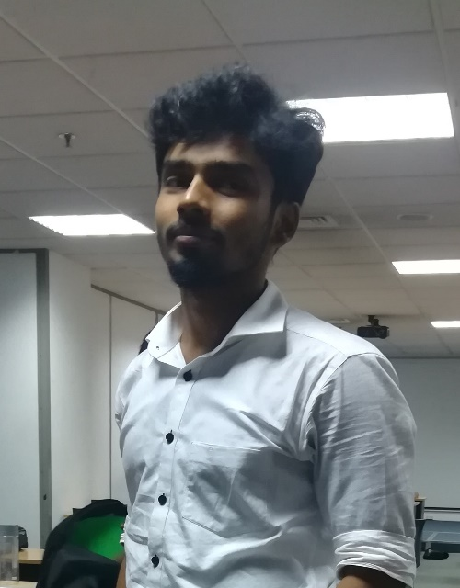
IT18186048-M.Anjanan
Bsc. Hons Information Technology specialization in Software Engineering

Slide 31
Introduction
Farmers have trouble in fixing a price for their crop.
So having the knowledge of prices of retail market will give them an edge choosing what plants to grow and commercialize them in a better way.

Slide 32
Price prediction of Sri lankan Vegetables
Research Gap
Algorithms used to produce results pay more attention to trends and patterns in past data , so when it varies accuracy varies.
Research Question
How can farmers get a price of vegetable beforehand?
Can the accuracy of the prediction increased?
Solution and objectives
A mobile application solution where we can get the approximate future prices with better accuracy

Slide 33
Research Methodology
Data collection from Central Bank of Srilanka Website
Technology:
Python, Flask, LSTM, Android

Slide 34
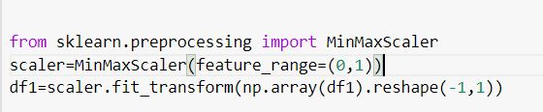
Algorithm and methods
Data is preprocessed in the scale of 0 to 1 in order to feed into the models.

Slide 35
ARIMA vs LSTM
ARIMA is the widely used algorithm for price predictions
It pays more attention to trends and pattern in data
Solution: LSTM is trained from the past data using neural networks.

Slide 36
System Diagram
Univariant timeseries analysis performed inorder to select a LSTM model among LSTM models with various hidden layers.
Models
LSTM
Stacked LSTM
Bidirectional LSTM

Slide 37
RMSE metric for bench marking the models. For cabbage vegetable.
 | Bidirectional LSTM | Stacked LSTM | Vanila LSTM
Train error | 0.0215 | 0.02406 | 0.0212
Test error | 0.04 | 0.0433 | 0.0249
Vanila LSTM performs better as other models tends to overfit the data . Where as Vanila LSTM performs better to these data.

Slide 38
LSTM on five vegetables and their errors
 | Carrot | Leeks | Bean | Cabbage
Train error | 0.01381 | 0.02939 | 0.01495 | 0.0220
Test error | 0.0242 | 0.0238 | 0.01153 | 0.0273

Slide 39
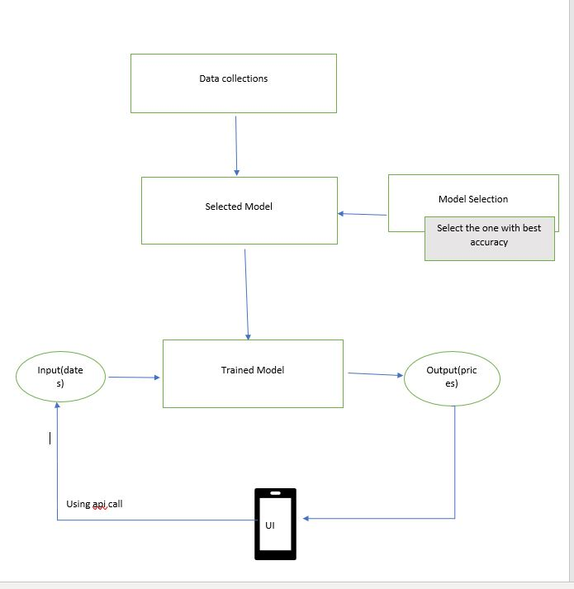
Future tasks
Create a front-end android application
Create backend api and get inputs
Using the trained model get the output and display it in the android

Slide 40
Commercialization
Globalizing the product using providing an option to farmers to upload their own market prices to the app
Deploy app to the google play store

Slide 41
References
Are middlemen facilitators or barriers to improve smallholders' welfare in rural economies? Empirical evidence from Ethiopia- Gumataw. K. Abebe-2015
5 Tech Startups In India Working to Weed Out Middlemen From Agriculture Supply Chain - 26/09/2020 - https://analyticsindiamag.com/5-tech-startups-in-india-working-to-weed-out-middlemen-from-agriculture-supply-chain
Changshou Luo and Qingfeng Wei1, Prediction of Vegetable Price Based on Neural Network and Genetic Algorithm- Institute of Information on Science and Technology of Agriculture, Beijing Academy of Agriculture and Forestry Sciences, Beijing
Yung-Hsing Peng, Chin-Shun Hsu, and Po-Chuang Huang, "Developing Crop Price Forecasting Service Using Open Data from Taiwan Markets", 2015.
format

Slide 42
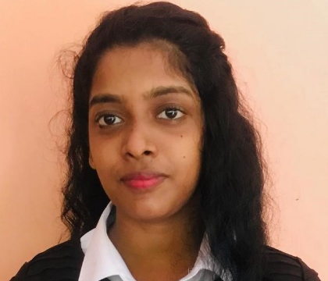
E-Commerce Platform for Farmers
Using Natural Language Processing chatbot
It18179118 | Keeyani Sivagnanam
BSc Hons Information Technology

Slide 43
Overall Project Description
Introduction
System Diagram
Methodology
Achievement
Objectives
Research Problem
Research Gap
Research Question

Slide 44

Introduction
There are many E-commerce platforms for farming activities. But which platforms are not fulfills all types of user requirements.
Chatbot is most important part for E-commerce farming activity.
Farmers spending too much of time to identify some new farming product names for buying and selling purpose.
Our NLP technology chatbot providing solutions for farmers problems by using Natural Language Process.

Slide 45





Technologies
Python
Pycharm IDE
Flutter
postman

Slide 46
Main objectives and sub objective
Data collection NLP Chatbot application
Develop a chatbot to discuss the issues related to farming and suggest the correct name in Natural Language Processing.
By using AI method of communicating with an intelligent system by Natural Language.
Support farmers to make timely decision in farming.
IT18179118 | Keeyani Sivagnanam| <2021_135>

Slide 47
Research Gap
Research Question
Farmers can’t understand the standard languages output from chatbot.
Farmers have an idea of a product but they don’t know the actual name.
Creative Solution
Using chatbot to typing their simple description of the vegetables and fruits.
Providing correct name in Natural Language Processing.
ITXXXXXXXX | <<Student Name>> | <<Project ID>>

Slide 48

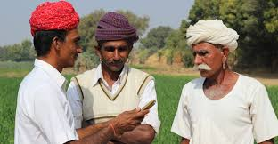
Methodology
NLP
Getting description from farmers
Processing description
Chatbot will provide accurate name.
IT18260502 | K.MARUTHI

Slide 49
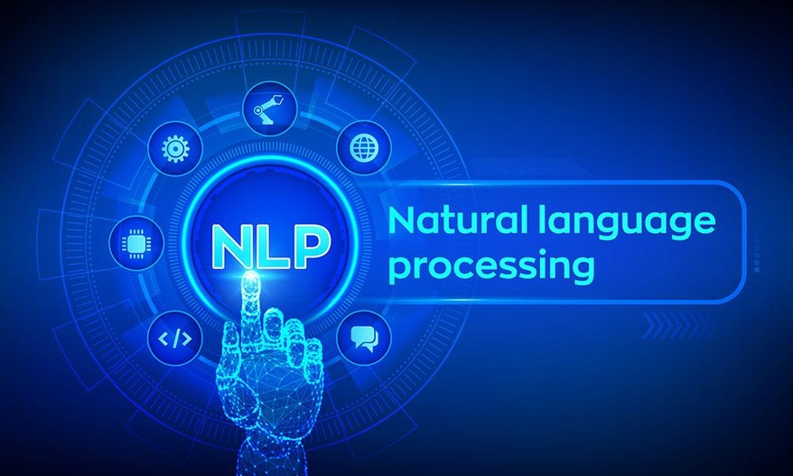
Achievements and Individual Progress
Identifying farmers problem
Requirements & Dataset Gathering
Design and Develop the Analysis Model
Train the Model Using Dataset
Testing the API output
IT18260502 | K.MARUTHI

Slide 50
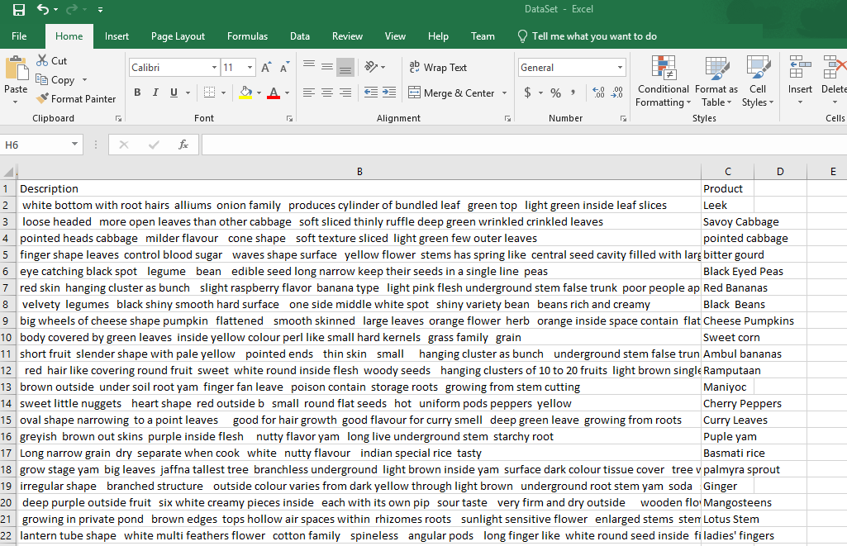
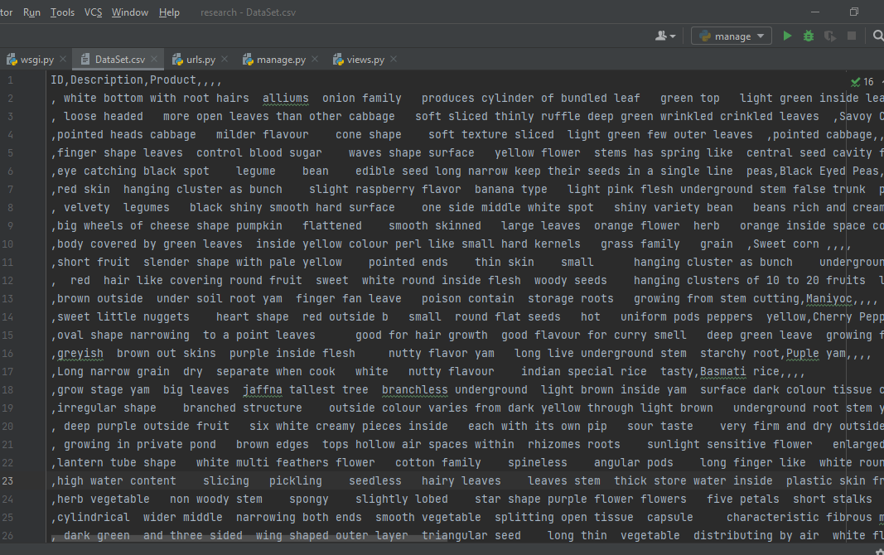
Achievements
Original CSV Dataset
Dataset Dictionary

Slide 51
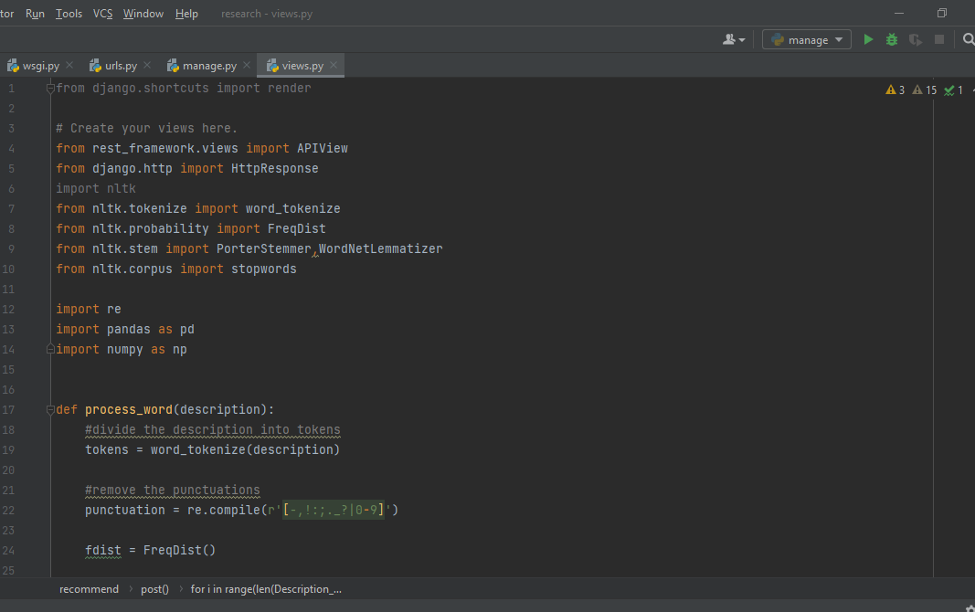
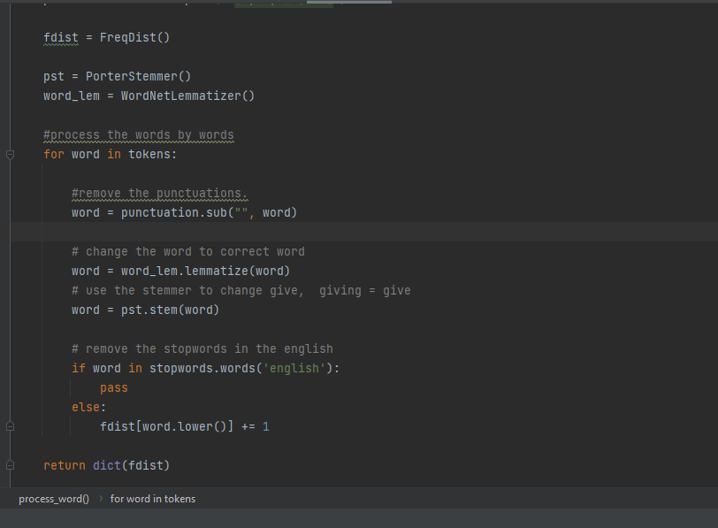
Achievements
NLP code implementation
Dataset Processing code implementation
IT18260502 | K.MARUTHI

Slide 52
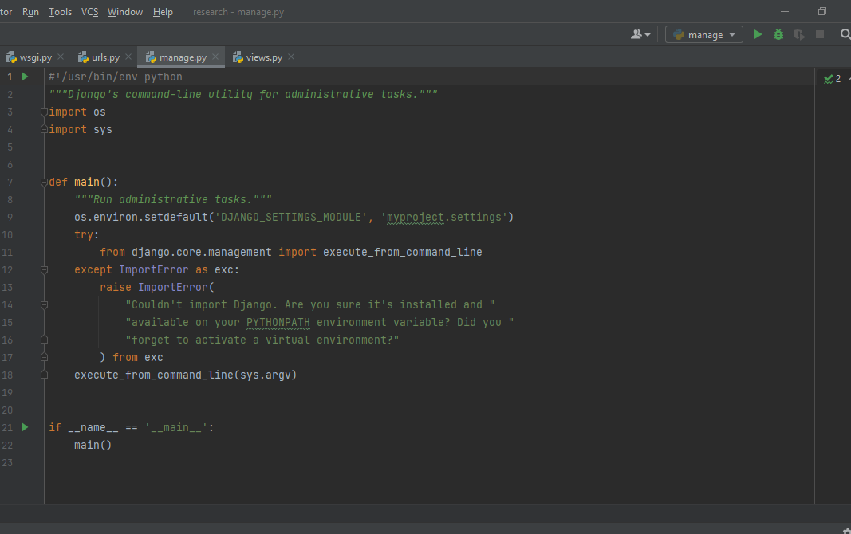
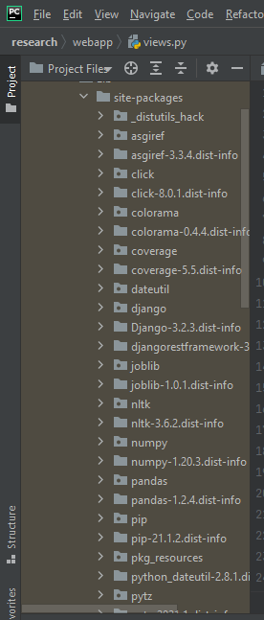
Django implementation
Imported libraries

Slide 53
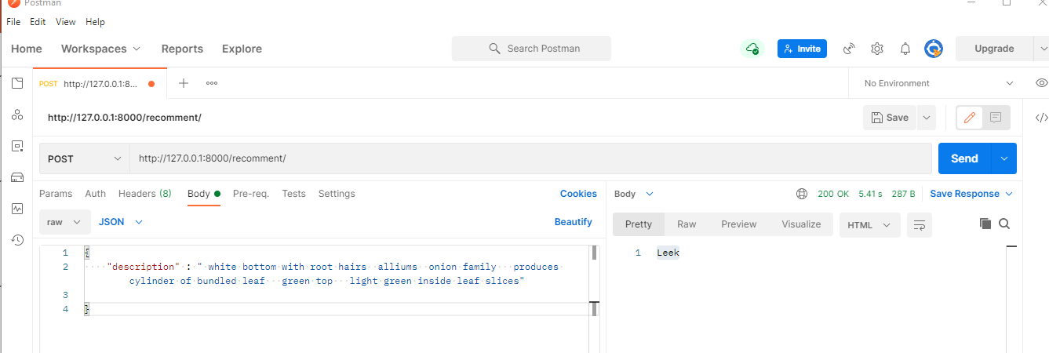
Achievements
Postman output
IT18260502 | K.MARUTHI

Slide 54
Task to be Achieve
Design the user friendly interface
Developing Interface using Flutter
Getting feedback from users.
Integrating the model
Improve the model to increase accuracy
IT18260502 | K.MARUTHI

Slide 55
Data Preprocessing
Removing Unnecessary things
Compute similar words
Releasing output
Remove spaces and characters from user description
Suggest similar words to the word being subjected to the prediction model.
Releasing accurate product name

Slide 56
Thank you

